Slide 1
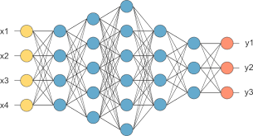
Deep Feedforward Networks
Adapted from Lecture slides of Deep Learning Chapter 6 by Ian Goodfellow

Slide 2
Artificial Neural Networks
Historical
Data
training
phase
test
phase
D: {(x, y)}
T: {(x, ?)}
Training
D
Test
T
信用卡申請人資料
(收入、不動產、工作、婚姻、年紀…)
新申請者資料
(Input)
……
……
W_{i}
W_{i}’
Learning Algorithm
W_{j}
W_{j}’
Error
(Loss)
核准否(y)
(Current Output)
核准否(y)
(Desired Output from training data)
建議核准否?
(Output)

Slide 3
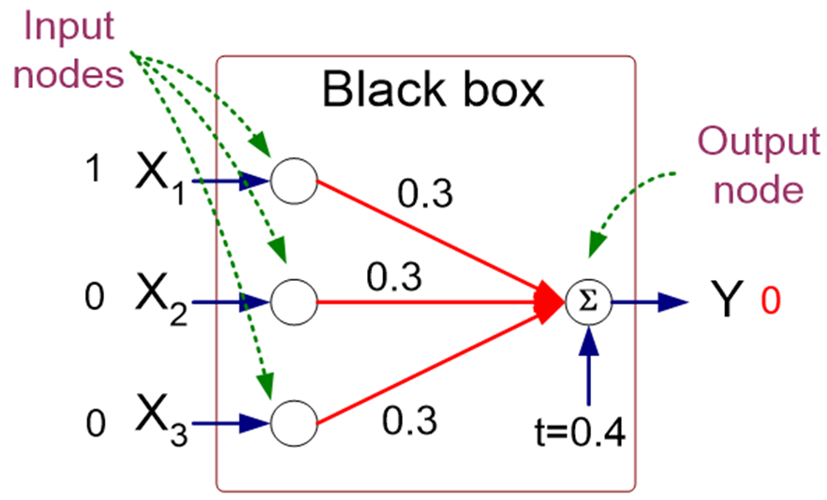
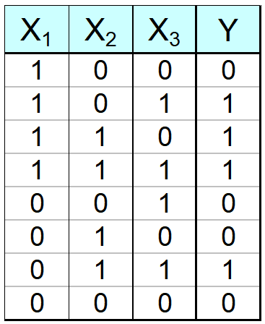
Artificial Neural Networks (ANN)
Training Data
Data point 1
(1 0 0 0)
// Indicator function

Slide 4
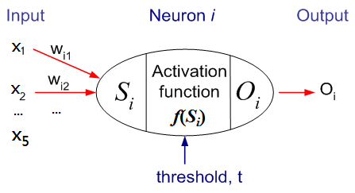
General Structure of ANN
w_{ij}
w_{jk}
Training ANN means learning the weights of the neurons

Slide 5
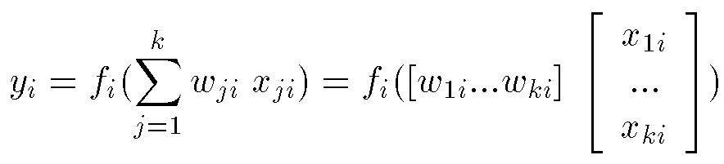
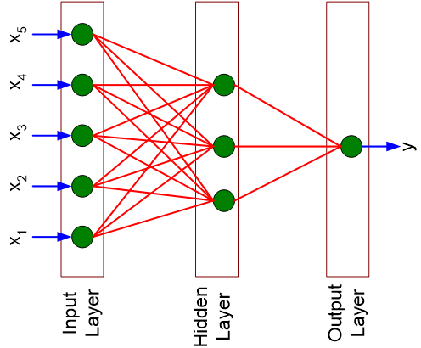
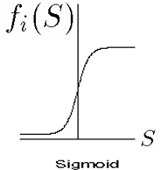
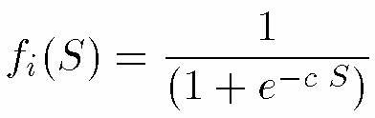
Computation of Node’s Output
Activation functions f_{i} is associated with nodes in graph.
Output will be in the range [0,1] if the Sigmoid function is used
x_{1i}
w_{1i}
y_{i}
…
f_{i}
x_{ki}
w_{ki}
Node_{i}
1
Activation function-
Sigmoid Function

Slide 6
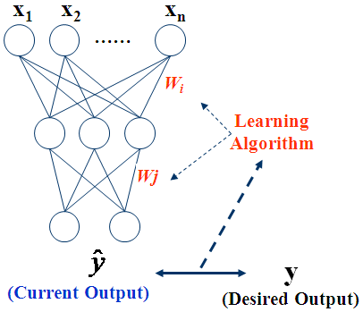
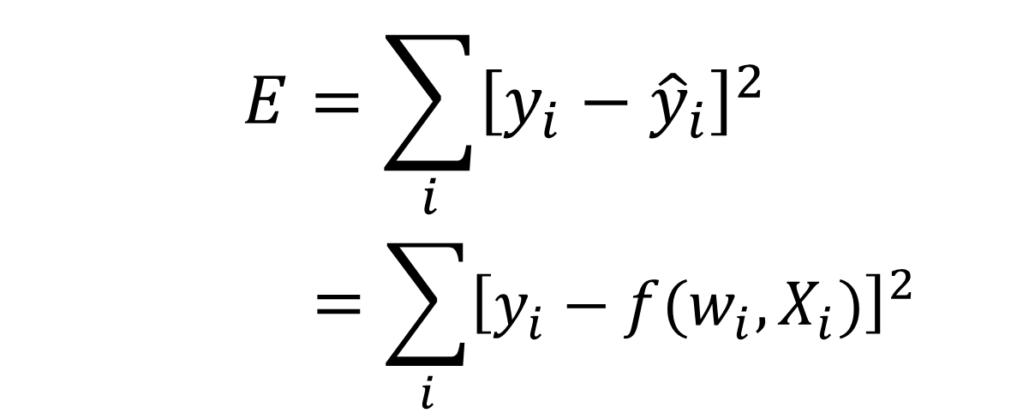
Algorithm for Learning ANN
Initialize the weights (w₀, w₁, …, w_{k})
Adjust the weights in such a way that the output of ANN is consistent with target output of training examples
Find the weights w_{i}’s that minimize the error function (or loss function).
e.g., backpropagation algorithm: Minimize E by gradient-decent method
n-dimensional data
$$E=\sum_{i}{{\left[y_{i}−{\hat{y}}_{i}\right]}^{2}}$$
$$=\sum_{i}{{\left[y_{i}−f(w_{i},X_{i})\right]}^{2}}$$
Error E
i: the i^{th} input instance
6

Slide 7
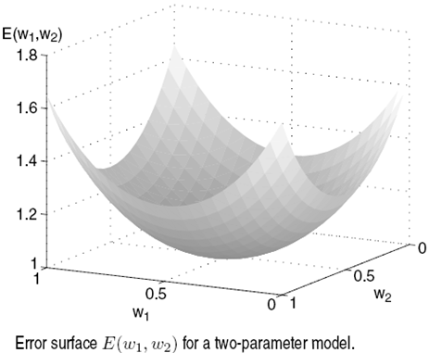
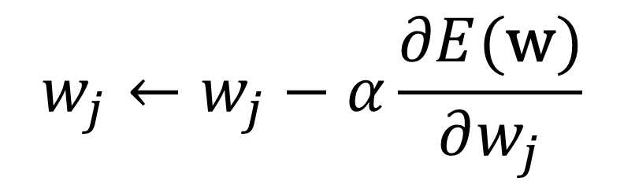
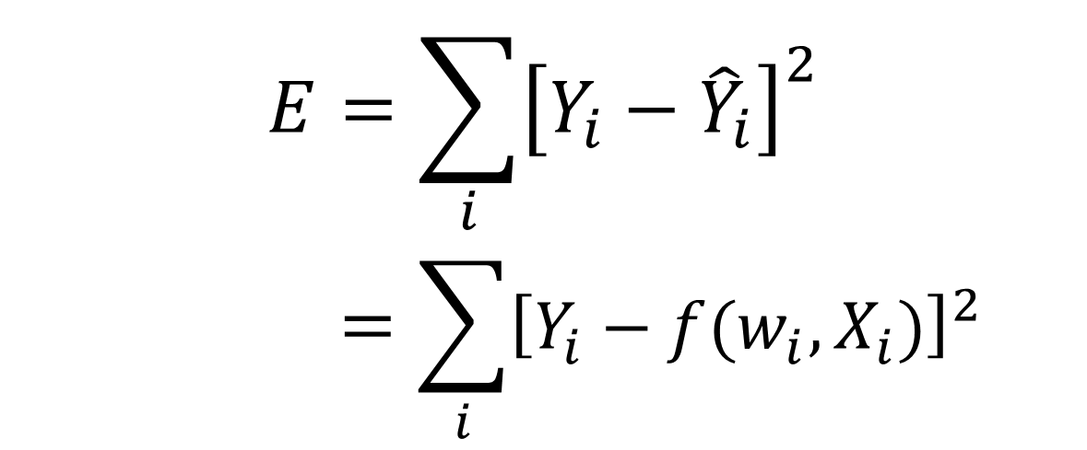
Minimize Error Function by Gradient-Decent Method
$$E=\sum_{i}{{\left[Y_{i}−{\hat{Y}}_{i}\right]}^{2}}$$
$$=\sum_{i}{{\left[Y_{i}−f(w_{i},X_{i})\right]}^{2}}$$
(w₁, w₂)
i: the i^{th} input instance
…
Minimize E by weight update:
gradient-decent method
$$w_{j}←w_{j}−α\frac{∂E(\text{w})}{∂w_{j}}$$

Slide 8

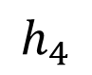
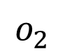
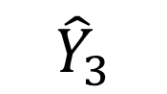
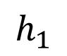
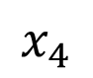
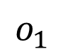
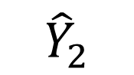
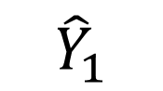
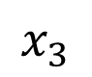
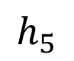
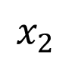
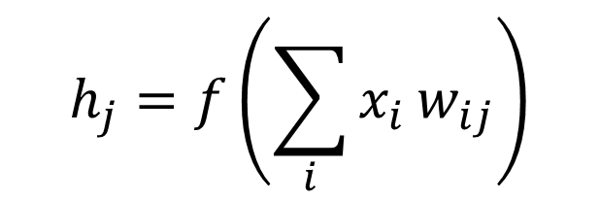
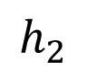
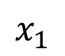
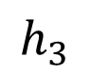
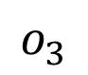
Learning/Training:
Stochastic Gradient Decent to adjust the weights backwards.
w₁₁₁
w₂₁₁
Training Data (Input)
Training Data
(Output)
w₁₁
$$h_{1}$$
X1 | X2 | X3 | X4
4 | 0 | 12 | 5
8 | 1 | 32 | 7
… | … | … | …
… | … | … | …
5 | 1 | 30 | 3
9 | 0 | 16 | 4
(Loss/Error)
$$x_{1}$$
w₁₂
Y1 | Y2 | Y3
0 | 1 | 0
1 | 0 | 0
… | … | …
… | … | …
1 | 1 | 0
0 | 0 | 1
1
2
$$h_{2}$$
$$o_{1}$$
$${\hat{Y}}_{1}$$
0.1
0.7
0.2
1
2
$$x_{2}$$
…
…
$$h_{3}$$
$$o_{2}$$
$${\hat{Y}}_{2}$$
…
…
$$x_{3}$$
$$h_{4}$$
$$o_{3}$$
$${\hat{Y}}_{3}$$
N
$$x_{4}$$
w₄₄
N
w₄₅
$$h_{5}$$
w₂₇₃
w₁₅₇
機器學習要項：
資料集
模型
損失函式
優化器
$$h_{j}=f\left(\sum_{i}{x_{i}}w_{ij}\right)$$
f : activation function

Slide 9
Roadmap
Example: Learning XOR
Gradient-Based Learning
Hidden Units
Architecture Design
Back-Propagation

Slide 10
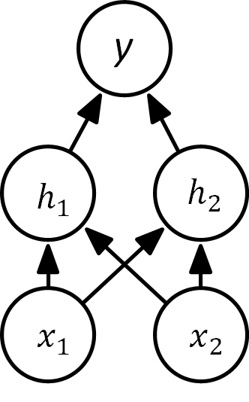



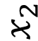
XOR is not linearly separable
Original x space
1
$$x_{2}$$
0
0
$$x_{1}$$
1
A linear model applied directly to the original input cannot implement the XOR function.
In the transformed space represented by the features extracted by a neural network, a linear model can now solve the problem.

Slide 11
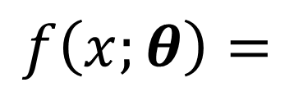
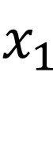
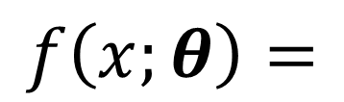
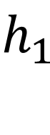
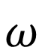
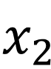
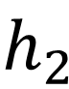
Network Diagrams
$$f\left(x;θ\right)=$$
h
$$f\left(x;θ\right)=$$
model parameters
y
y
$$ω$$
h
$$h_{1}$$
$$h_{2}$$
W
x
$$x_{1}$$
$$x_{2}$$

Slide 12
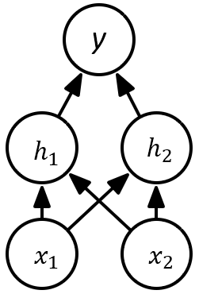

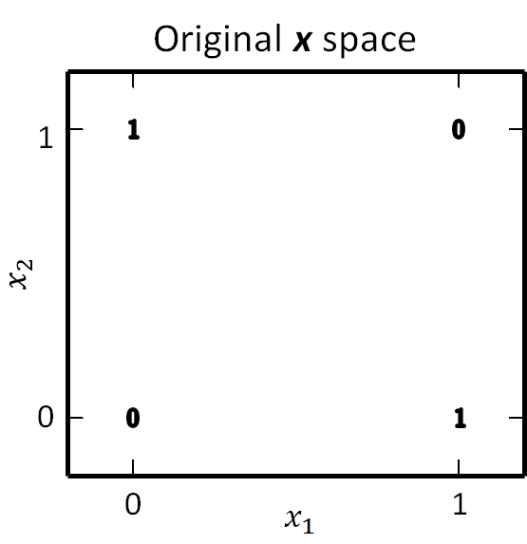
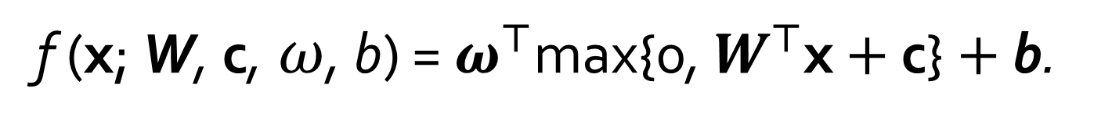
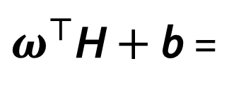
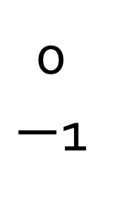
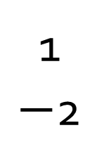
Solving XOR
// x and c are column vectors
f (x; W, c,$ω$, b) = $ω^{⊤}$max{0, $W^{⊤}$x $+$ c} $+$ b.
1
1 1
1 1
0
$−$1
1
$−$2
W =
,
c =
,
w =
,
b = 0
w
W
0 1
$ω^{⊤}$H $+$ b =
H =
Neural networks transform the input data so that the problem can be solved more easily.

Slide 13
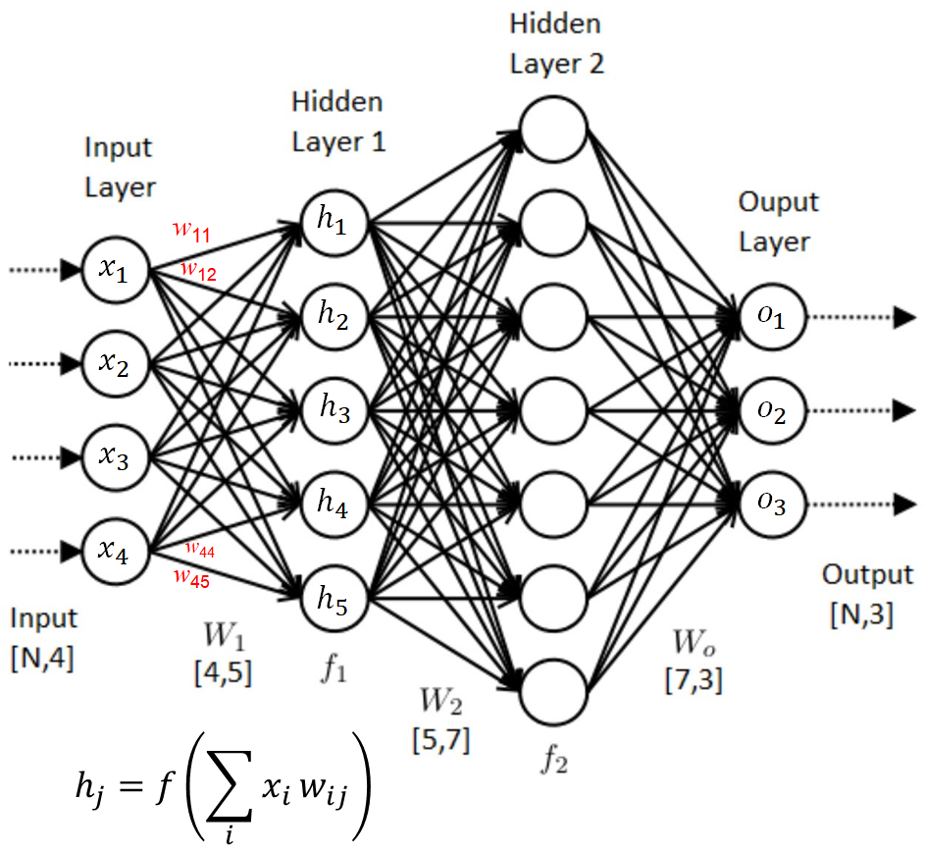
Roadmap
Example: Learning XOR
Hidden Units
Gradient-Based Learning
Architecture Design
Back-Propagation

Slide 14
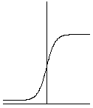
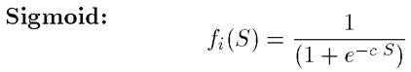
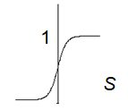
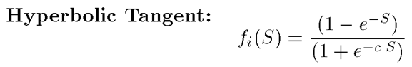
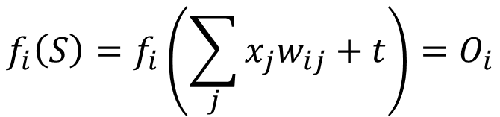

Activation Functions
O
S
// usually used in output layer for regression problem
$$f_{i}\left(S\right)=f_{i}\left(\sum_{j}{{x_{j}w}_{ij}}+t\right)=O_{i}$$
ReLU (Rectified Linear Unit):
$$f_{i}\left(S\right)=max(0,S)$$
O
// usually used in hidden layers
ReLU:
f₁(-100) = 0
f₂(70) = 70
S
1
S
// usually used in output layer for binary classification problem
-1

Slide 15





Activation Functions
1
Used in RBF NN (Radial Basis Function NN)
Because it saturates to 0 for most x, it can be difficult to optimize.
0
S
O
T
S
O
S
T₁
T₂

Slide 16


Activation Functions
g(a)
Softplus
Smooth version of the rectifier.
Rectifier was found better than softplus (Glorot et al., 2011) .
The use of the softplus is generally discouraged.
Hard tanh
where e = 2.718
a
g(a)
a
E.g., g(5), g(0.8), g(-5)

Slide 17



Generalizations of rectified linear units
Use ReLUs, 90% of the time
Three generalizations of rectified linear units are based on using a nonzero slope α_{i} when z_{i} < 0:
Absolute value rectification fixes α_{i} = -1 to obtain g(z) = |z|
Leaky ReLU fixed α_{i} to a small value like 0.01.
Parametric ReLU or PReLU treats α_{i} as a learnable parameter.
O
S
$$h_{i}\left(S\right)=max(0,S)$$
$$h_{i}=g{(z,α)}_{i}=max⁡(0,z_{i})+α_{i}min(0,z_{i})$$
ReLU: α_{i} = 0
Leaky ReLU:
g(5, 0.01)
g(-0.5, 0.01)
g(-1, 0.01)
g(-500, 0.01)
1. Absolute value rectification
2. Leaky ReLU

Slide 18




Activation Function: Mish and Swish
Mish
Swish
$$f\left(x\right)=x∙tanh\left(softplus\left(x\right)\right)$$
$$=xtanh(\ln\left(1+e^{x}\right))$$
$$f\left(x\right)=x∙sigmoid\left(x\right)$$

Slide 19


Avoid using sigmoidal hidden units
Prior to the introduction of rectified linear units, most neural networks used the logistic sigmoid activation function or the hyperbolic tangent activation function.
The widespread saturation of sigmoidal units can make gradient-based learning very difficult. For this reason, their use as hidden units in feedforward networks is now discouraged.
When a sigmoidal activation function must be used, the hyperbolic tangent activation function typically performs better than the logistic sigmoid.
These activation functions are closely related because tanh(z) = 2σ(2z) − 1.
In a saturated neuron, where change to w and b lead to only minuscule changes in a, this learning slows to a crawl: If adjustments to w and b make no discernible impact on a given neuron’s activation a, then these adjustments cannot have any discernible impact downstream (via forward propagation) on the network’s y’, the estimate of y. (from ch 8, DP illustrated)

Slide 20


Maxout Units
Maxout units divide z into groups of k values.
Each maxout unit then outputs the maximum element of one of these groups:
where i: the i^{th} group

Slide 21


Roadmap
Example: Learning XOR
Hidden Units
Gradient-Based Learning
Architecture Design
Back-Propagation
sigmod/softmax/…
Training
Loss
Data
binary cross entropy/
mse/
…
adam/rmsprop/…
Validation
Performance
(metric)
Test
evaluation

Slide 22



Gradient-Based Learning
Specify
Model
number of layers, units, activation function, … (hyperparameters) //determined by user in advance
Loss (or Cost)
Design model and cost so cost is smooth
Minimize cost using gradient descent or related techniques
Loss
(Cost)
Loss/Cost
$$Y_{1}$$
$Y_{2}$
$$Y_{3}$$
w₂
w₁
Weights
(Parameters)

Slide 23




Output Types
Problem Type | Last-layer Activation | Cost/Loss Function | Example
Binary classification | Sigmoid | Binary cross-entropy | Yes/no problems
Multiclass, single-label classification | Softmax | Categorical cross-entropy | Single object recognition
Multiclass, multilabel classification | Sigmoid | Binary cross-entropy | Multi object detection
Regression to arbitrary values | None | Mean squared error (MSE) | Stock price prediction
Regression to values between 0 and 1 | Sigmoid | MSE or binary cross-entropy
1
Cow
Cat
…
…
Dog
Is this a cow?
What is it?
What are they?

Slide 24











Binary Cross Entropy for Single Class Classification
$$x$$
$$w$$
True
$$y$$
$$\hat{y}$$
0.9 1
0.9 0
Case1 y = 1: -(1*log 0.9 + (1 - 1)*log (1 - 0.9)) = 0.046
Binary Cross Entropy
Case2 y = 0: -(0*log 0.9 + (1 - 0)* log (1 - 0.9)) = 1
Assume the predicted value $\hat{y}$ = 0.9
The closer the predicted value to the true value, the smaller the cross entropy.
where N: number of data points

Slide 25




Learning with Binary Cross Entropy
Cross-entropy cost is structured so that the larger the difference between $\hat{y}$ and $y$, the faster the neuron is able to learn.
Binary cross entropy (or BCE)
$$Loss=−\frac{1}{N}\sum_{n=1}^{N}{y_{n}\log{{\hat{y}}_{n}+{(1−y}_{n})log(1−{{\hat{y}}_{n})}}}$$
$$y$$ | $$\hat{y}$$ | Loss
1 | 0.9997 | 0.00013
1 | 0.9 | 0.046
1 | 0.6 | 0.222
1 | 0.1192 | 0.924
0 | 0.1192 | 0.055
1 | 1-0.1192 | 0.055
where N: number of data points
w_{n1}
BCE loss
ground
truth

Slide 26




Multi-Class Classification with Softmax Regression
294 3 3
→ 294/300 3/300 3/300
→ 0.98 0.01 0.01
The softmax activation function is the analogue of the sigmoid for more then two classes.
Each element of the output is in between 0 and 1.
(1 0 0)
$$softmax\left(x\right)=\frac{1}{\sum_{j=1}^{K}{exp⁡(x_{j})}}\left[\begin{aligned}\begin{matrix}exp⁡(x_{1}) \\ exp⁡(x_{2}) \\ …\end{matrix} \\ exp⁡(x_{k})\end{aligned}\right]$$
// exp(x₁): $e^{x_{1}}$
(0.98 0.01 0.01)
0.98 0.01 0.01
(0.01 0.98 0.01)
Cow
Cat
Dog
softmax
Max-likelihood loss function is categorical cross entropy
$$L\left(y,\hat{y}\right)=−y^{T}log \hat{y}=−\sum_{i=1}^{k}{y_{i}\log{{\hat{y}}_{i}}}$$
where k: number of categories.
$$L(y,\hat{y})=−\sum_{i=1}^{k}{y_{i}\log{{\hat{y}}_{i}}=−\left(1log 0.98+0log 0.01+0log 0.01\right)=−log 0.98≈0.02}$$
// (0.98 0.01 0.01)
$$−\left(1log 0.01+0log 0.98+0log 0.01\right)=−log 0.01=2$$
// (0.01 0.98 0.01)
If the prediction is close to the ground truth, the loss will be small.

Slide 27








Loss Function: Mean Squared Error or MSE
Regression applications:
stock price prediction, power generation forecasting, sales prediction, …
$$x$$
$$w$$
Ground Truth
$$y$$
$$\hat{y}$$
Loss
Mean Squared Error (MSE)
Predictions and ground truths of five data points:
$$\hat{y}=\left[−1.2 −1.4 0.7 0.9 1.2\right]$$
$y=$ $\left[−1.1 −0.9 0.6 0.9 1.4\right]$
where N: number of data points

Slide 28





Popular Performance Metrics
Indicator function
$$I\left(x\right)=\left\{\begin{aligned}1 if x=true \\ 0 if x=false\end{aligned}\right.$$
Accuracy //for classification problems
$$ACC=\frac{1}{N}\sum_{i=1}^{N}{{I(\hat{y}}_{i}=y_{i})}$$
Training
Loss
MAE (Mean absolute error)
$$MAE=\frac{1}{N}\sum_{i=1}^{N}{\left|{\hat{y}}_{i}−y_{i}\right|}$$
MSE (Mean squared error)
$$MSE=\frac{1}{N}\sum_{i=1}^{N}{{({\hat{y}}_{i}−y_{i})}^{2}}$$
RMSE (Root mean square error)
$$RMSE=\sqrt{\frac{1}{N}\sum_{i=1}^{N}{{({\hat{y}}_{i}−y_{i})}^{2}}}$$
MAPE (Mean absolute percentage error)
$$MAPE=\frac{1}{N}\sum_{i=1}^{N}{\left|\frac{{\hat{y}}_{i}−y_{i}}{y_{i}}\right|}×100\%$$
Data
Validation
Performance
(metric)
Test
evaluation
For classification problems:
$\hat{y}=\left[0 1 1 0 0 1 1 0 1 1\right]$
$y=$ $\left[0 0 1 0 0 1 0 0 1 1\right]$
N = 10
For regression problems:
$\hat{y}=\left[−1.2 −1.4 0.7 0.9 1.2\right]$
$y=$ $\left[−1.1 −0.9 0.6 0.9 1.4\right]$
N = 5

Slide 29








A First Look at a Neural Network
from keras.datasets import mnist #MNIST dataset
from keras import models
from keras import layers
from keras.utils import to_categorical
(X_train, y_train), (X_test, y_test) = mnist.load_data()
network = models.Sequential()
network.add(layers.Dense(1000, activation='relu', input_shape=(28 * 28,)))
network.add(layers.Dense(10, activation='softmax’))
network.compile(optimizer='rmsprop', loss='categorical_crossentropy',
metrics=['accuracy’])
MNIST dataset:
60000 training samples
10000 test samples
28×28 pixels
$$x$$
$$W_{784×1000}$$
$$h$$
train_images = train_images.reshape((60000, 28 * 28))
train_images = train_images.astype('float32') / 255 #normalization
test_images = test_images.reshape((10000, 28 * 28))
test_images = test_images.astype('float32') / 255
train_labels = to_categorical(train_labels)
test_labels = to_categorical(test_labels)
network.fit(train_images, train_labels, epochs=5, batch_size=128)
test_loss, test_acc = network.evaluate(test_images, test_labels)
print('test_acc:', test_acc)
$$W_{1000×10}$$
$$\hat{y}$$
Multi-class, single label problem
Each iteration over all the training data is called an epoch.
One update per batch_size training data
60,000/128 = 469 gradient updates per epoch
Perform 469*5 = 2,345 updates in total
https://github.com/fchollet/deep-learning-with-python-notebooks

Slide 30
from keras.datasets import imdb
from keras import models, layers
import numpy as np
(train_data, train_labels), (test_data, test_labels) = imdb.load_data(num_words=10000) # top 10,000 frequently occurring words
def vectorize_sequences(sequences, dimension=10000):
results = np.zeros((len(sequences), dimension))
for i, sequence in enumerate(sequences):
results[i, sequence] = 1. # set specific indices of results[i] to 1s
return results
x_train = vectorize_sequences(train_data)
x_test = vectorize_sequences(test_data)
y_train = np.asarray(train_labels).astype('float32')
y_test = np.asarray(test_labels).astype('float32’)
# Movie review dataset; 25,000 reviews for training; 25,000 reviews for testing
Movie review:
"? this film was just brilliant casting location scenery story direction everyone's really suited the part they played and you could just imagine being there robert ? is an amazing actor and now the same being director ? Father …”
>>> x_train[0] #vectorized review
array([ 0., …, 1., …, 0, …, 1., ..., 0., 0.])
model = models.Sequential()
model.add(layers.Dense(16, activation='relu', input_shape=(10000,)))
model.add(layers.Dense(16, activation='relu'))
model.add(layers.Dense(1, activation='sigmoid’))
model.compile(optimizer='rmsprop’, loss='binary_crossentropy', metrics=['accuracy’])
… …
10000
…
16
x_val = x_train[:10000] # first 10,000 for validation
partial_x_train = x_train[10000:] # the remaing 15,000 for training
y_val = y_train[:10000]
partial_y_train = y_train[10000:]
history = model.fit(partial_x_train, partial_y_train, epochs=20, batch_size=512, validation_data=(x_val, y_val))
…
16
1 positive/negative
(Yes/No problem)

Slide 31


The Boston Housing Price dataset
$$mse=\frac{1}{b_s}\sum_{i}{{\left(y_{i}−{\hat{y}}_{i}\right)}^{2}}$$
from keras.datasets import boston_housing
(train_data, train_targets), (test_data, test_targets) = boston_housing.load_data()
$$mae=\frac{1}{b_s}\sum_{i}{\left|y_{i}−{\hat{y}}_{i}\right|}$$
mean = train_data.mean(axis=0) # cannot include test data
train_data -= mean # 13 features in the input data
std = train_data.std(axis=0)
train_data /= std # z-score data normalization
test_data -= mean
test_data /= std
Input features
…
13
… …
64
from keras import models
from keras import layers
def build_model():
model = models.Sequential()
model.add(layers.Dense(64, activation='relu’, input_shape=(train_data.shape[1],)))
model.add(layers.Dense(64, activation='relu'))
model.add(layers.Dense(1))
model.compile(optimizer='rmsprop', loss='mse', metrics=['mae'])
return model
… …
64
…
1
Regression problem
(Housing Price)
Price
# linear sum, no activation function
# mse: mean squared error
# mae: mean absolute error
…
model.fit(train_data, train_targets, epochs=80, batch_size=16, verbose=0) #verbose=0 no output during training
test_mse_score, test_mae_score = model.evaluate(test_data, test_targets)

Slide 32




Roadmap
Example: Learning XOR
Hidden Units
Gradient-Based Learning
Architecture Design
Back-Propagation
y
Depth
$$h_{1}$$
$$h_{2}$$
$$x_{1}$$
$$x_{2}$$
Width

Slide 33



Architecture Basics
Most neural network architectures arrange these layers in a chain structure, with each layer being a function of the layer that preceded it.
Deeper networks often are able to use far fewer units per layer and far fewer parameters and often generalize to the test set, but are also often harder to optimize.
y
W⁽²⁾
Depth
$$h_{1}$$
$$h_{2}$$
h⁽¹⁾
// bias
W⁽¹⁾
$$x_{1}$$
$$x_{2}$$
x
$$y_{1×1}=g^{(2)}(W_{2×1}^{\left(2\right)T}h_{2×1}^{(1)}+b_{1×1}^{(1)})$$
$$h_{2×1}^{(1)}=g^{(1)}(W_{2×2}^{\left(1\right)T}x_{2×1}+b_{2×1}^{(1)})$$
Width

Slide 34

Universal Approximator Theorem
One hidden layer is enough to represent (not learn) an approximation of any function to an arbitrary degree of accuracy
Learning can fail for two different reasons:
The optimization algorithm used for training may not be able to find the value of the parameters that corresponds to the desired function
The training algorithm might choose the wrong function due to overfitting
There is no universal procedure for examining a training set of specific examples and choosing a function that will generalize to points not in the training set.
A feedforward network with a single layer is sufficient to represent any function, but the layer may be infeasibly large and may fail to learn and generalize correctly.
So why deeper?
Shallow net may need (exponentially) more width
Shallow net may overfit more
Using deeper models can reduce the number of units required to represent the desired function and can reduce the amount of generalization error.

Slide 35


Better Generalization with Greater Depth
Empirically, greater depth does seem to result in better generalization for a wide variety of tasks
Large, shallow models overfit more
Shallow models in this context overfit at around 20 million parameters while deep ones can benefit from having over 60 million.

Slide 36




Roadmap
Example: Learning XOR
Hidden Units
Gradient-Based Learning
Architecture Design
Back-Propagation
Compute loss
y
Forward propagation
Compute activations
Compute derivatives Back-propagation
$$h_{1}$$
$$h_{2}$$
$$x_{1}$$
$$x_{2}$$

Slide 37




The loss score is used as a feedback signal to adjust the weights
Input X
0 1 1
W⁽¹⁾
$$w_{3,4}^{(1)}$$
W⁽²⁾
$$w_{4,4}^{(2)}$$
sigmod/softmax/…
Weight
update
W⁽³⁾
$$w_{4,1}^{(3)}$$
Loss
binary cross entropy/dice/
mse/mae/
…
1
True target
adam/rmsprop/…
0.6
Prediction

Slide 38


Simple Back-Propagation Example
$$w_{j}←w_{j}−α\frac{∂L(\text{W})}{∂w_{j}}$$
Update weight by gradient decent
Compute loss L
True target:
y^{(true)}
Forward propagation
y
Compute activations
Compute derivatives Back-propagation
$$h_{1}$$
$$h_{2}$$
$$x_{1}$$
$$x_{2}$$

Slide 39











Back-Propagation via Chain Rule
$$z$$
$$f$$
Back-propagation is “just the chain rule” of calculus
Suppose that y = g(x) and z = f (g(x)) = f (y). Then the chain rule states that
We can generalize this beyond the scalar case.
Suppose that x ∈ R^{m}, y ∈ R^{n}, g maps from R^{m} to R^{n}, and f maps from R^{n} to R .
If y = g(x) and z = f(y), then
$$y$$
$$\frac{ⅆz}{ⅆx}=\frac{ⅆz}{ⅆy}\frac{ⅆy}{ⅆx}$$
$$g$$
$$x$$
z
f
$$\frac{∂z}{∂x_{1}}=\frac{∂z}{∂y_{1}}\frac{∂y_{1}}{∂x_{1}}+\frac{∂z}{∂y_{2}}\frac{∂y_{2}}{∂x_{1}}$$
$$\frac{∂z}{∂x_{2}}=\frac{∂z}{∂y_{1}}\frac{∂y_{1}}{∂x_{2}}+\frac{∂z}{∂y_{2}}\frac{∂y_{2}}{∂x_{2}}$$
$$y_{1}$$
$$y_{2}$$
n
g
$$x_{1}$$
$$x_{2}$$
m

Slide 40



Back-Propagation
In vector notation, this may be equivalently written as the Jacobian-gradient product for each operation in the graph.
where ∂y/∂x is the n × m Jacobian matrix of g.
$$∇_{x}z={\left(\frac{∂y}{∂x}\right)}^{⊤}∇_{y}z=\sum_{j}{(∇_{X}Y_{j})\frac{∂z}{{∂Y}_{j}}}$$
z
y
y₁
y₂
…
y_{m}
n × m
m × 1
x
x₂
x₃
…
x_{n}
x₁

